Slide 1

IBM Data Science Capstone Project
Space X Falcon 9 Landing Prediction
William Larsson Krighom

Slide 2
OUTLINE
Executive Summary
Introduction
Methodology
Results
Conclusions
Appendix

Slide 3
EXECUTIVE SUMMARY
Summary of Methodologies:
These are the steps this report will go thru:
Data Collection
Data Wrangling
Exploratory Data Analysis
Interactive Visual Analytics
Predictive Analysis (Classification)
Summary of Results:
This project will produce sets of outputs and visualizations:
Exploratory Data Analysis (EDA) results
Geospatial analytics
Interactive dashboard
Predictive analysis of classification models

Slide 4

Introduction
SpaceX launches Falcon 9 rockets at a cost that is approximately $100m cheaper than other providers. The reason that SpaceX saves so much money is that they reuse the first stage of the rocket, but it is not always retrieved intact.
If we can predict whether the first stage lands successfully, we can figure out the cost of the launch, this information can be used to assess whether or not an alternate company should bid and SpaceX for a launch.

Slide 5
METHODOLOGY SUMMARY
Data Collection
Making GET requests to the SpaceX REST API
Web Scraping
Data Wrangling
.fillna() method is used to remove NaN values
With the .value_counts() method we can:
Se the number of launches for every site
Se the number and occurrence for every orbit
Se the number and occurrence of mission outcome for each orbit type
Making a landing outcome label that is:
1 if the booster landed successfully
0 if the booster was not landed successfully
Exploratory Data Analysis
With SQL queries were used on the dataset to manipulate and evaluate it
Pandas and Matplotlib were used to visualize the relationships between variables, and determine patterns
Interactive Visual Analytics
Folium was used to make geospatial analytics
A dashboard using Plotly was created for interactive visualisation
Data Modelling and Evaluation
Scikit-Learn was used to:
Pre-process /standardize data
Using the train_test_split method to split the data into training and testing data
Train a few different classification models
Using GridSearchCV to find hyperparameters
For every classification model Plot there corresponding confusion matrices
Assessing each classification models accuracy

Slide 6
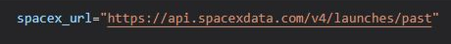
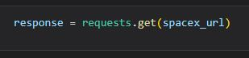
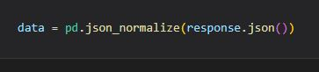
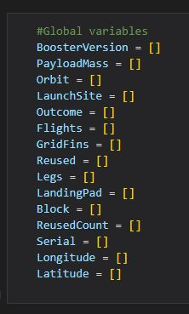
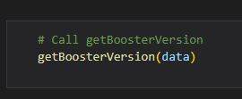
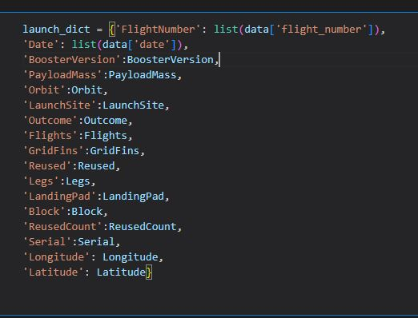
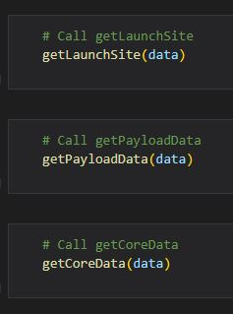
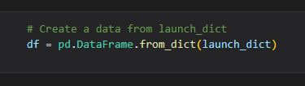
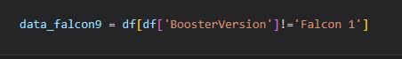
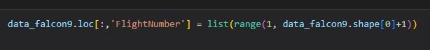
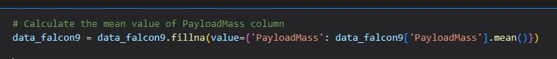
DATA COLLECTION – space x REST api
1
With the SpaceX API we retrieve the data about launches, information on the rocket, the payload delivered, specifications of the launch , specifications of the landing , and landing outcome.
2
1
Accessing the SpaceX REST API with a GET response
Then convert the response from .json file to a Pandas DataFrame
2
Make lists that are used to store data
Construct the DataFram by making a dictionary of the lists
3
Use the dictionary to create a Pandas DataFrame
3
4
Remove all the non Falcon 9 launches from the DataFrame
Replace the old FlightNumber in its column with a new index
Using the mean PayloadMass value to replace missing values
4
GitHub

Slide 7
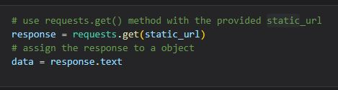
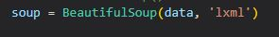
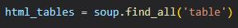
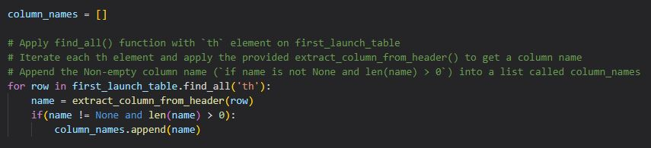
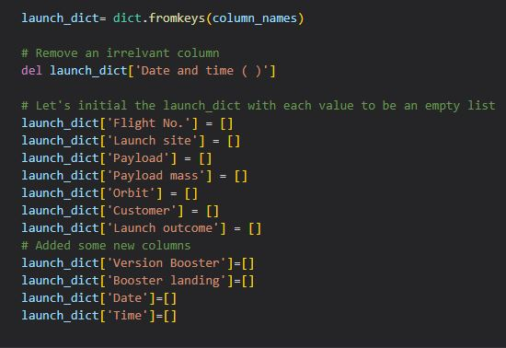
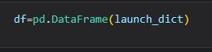
DATA COLLECTION – WEB SCRAPING
1
Web scraping the Wikipedia page titled List of Falcon 9 and Falcon Heavy launches to collect historical launch records.
2
1
Use the static URL to request the HTML page
Make a object to assign the response
3
2
Make a BeautifulSoup object with the HTML response
Find the tables in the HTML page
3
4
From the HTML page tables get all column header names
4
Make a dictionary with the column names as keys
5
Make a export ready Pandas DataFrame by converting the dictionary
GitHub
5

Slide 8
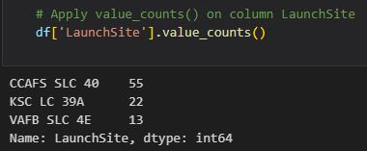
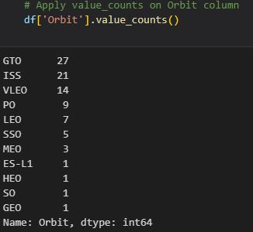
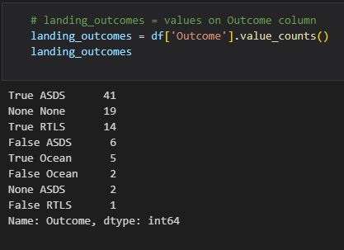
DATA MANIPULATION/WRANGLING – PANDAS
1
There is a column called LaunchSite the SpaceX dataset that contains several Space X launch facilities.
There exist several dedicated orbits that each launch aims to
Initial Data Exploration:
With the method .value_counts() we can determine the following:
How many launches there was from each site
How many times each orbit was targeted
For every orbit type what there number of outcomes was
2
3
GitHub

Slide 9
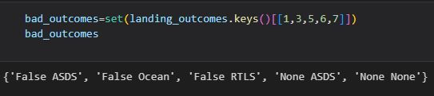
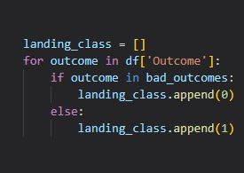
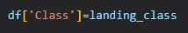
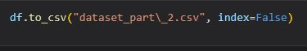
DATA MANIPULATION/WRANGLING – PANDAS
The landing outcomes can be found in the Outcome column:
True Ocean It landed in the Ocean
False Ocean It failed to land in the Ocean
True RTLS It landed on a ground pad
False RTLS It failed to land on a ground pad.
True ASDS It landed on a drone ship
False ASDS It failed to land on a drone ship.
None ASDS and None None Maens that it did not land.
Data Wrangling:
To make it easier to predict if there will be a successful landing we converted the outcomes to binary values i.e 1 for success and 0 for failed. This is how it's done:
Creating a set where all the unsuccessful outcomes are stored, bad_outcome
Making a list that we fil with 0 if the current row belongs to bad_outcome and 1 otherwise, called landing_class
Use landing_class to Create the Class column
Lastly export the data to a .csv file.
1
3
3
4
GitHub

Slide 10
Exploratory data analysis – visualization
SCATTER CHARTS
BAR CHART
LINE CHARTS
When visualizing the relationships/correlations between two variables scatter plots are one of the best ways to do it. In this presentation scatter plots were used to visualize the correlations between Flight Number and Launch Site, Orbit Type and Flight Number, Payload and Launch Site and Payload and Orbit Type
Bar charts are useful when comparing categorical and numerical variables. In this presentation a bar chart was used to visualize the Success Rate and Orbit Type
Line charts are useful when there is a numerical value that changes over time, in this presentation it is used to visualize the relationships between Success Rate and Year
GitHub

Slide 11
Exploratory data analysis (eda) – sql
These are the SQL queries performed on the data(what they did):
View all the names of launch sites
View 5 records where launch sites names start with ‘CCA’
Summarize all payload mass carried by boosters launched by NASA (CRS)
Get the average payload mass that boosters of version F9 v1.1 carried
Get the date of the first successful landing on a ground pad
Get the boosters that landed successfully with payload mass between 4000 and 6000 kg on a drone ship
Get the total number of successful and failed mission outcomes
Get what booster versions that have carried the maximum payload mass
Get the landing outcomes that failed to land on drone ships, what booster version they had and launch site names for 2015
Between the date 2010-06-04 and 2017-03-20 get the landing outcome and list them on descending order(by date)
GitHub

Slide 12
Geospatial analysis – folium
Put all the launch sites on the map
Started with making the Folium Map
Mark the launch sites on the map with folium.Circle and folium.Marker
Put the success/failed launches on each site
Sence many launches were on the same site they can be clustered this was done with the MarkerCluster() object
The markers were colour coded based on outcome.
GitHub

Slide 13
Interactive dashboard – plotly dash
px.pie() was used to make a Pie chart, the pie chart could be filtered with a dropdawn menu that was added with dcc.Dropdown()
px.scatter() was used to make a Scatter graph, a range slider was added with RangeSlider()
GitHub

Slide 14
Predictive Analysis - Classification
Model Development
Model Evaluation
Finding the Best Classification Model
1
To prepare the dataset for model development:
Load dataset
Clean data
Split data using train_test_split()
Decide which type of algorithms are most appropriate
For each chosen algorithm:
Use GridSearchCV
Fit to the parameters
Train the model
For every chosen algorithm:
Using the output GridSearchCV object:
Check the tuned hyperparameters
Check the accuracy
Plot Confusion Matrix
Review the accuracy scores
Chose the best model
GitHub

Slide 15

results

Slide 16
EDA - WITH VISUALIZATION

Slide 17
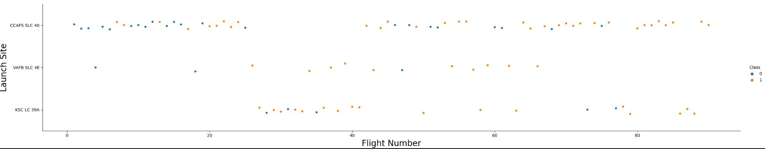
Launch Site VS. FLIGHT NUMBER
The y axis is the launch site and the x axis is the Flight number. The coulure of the dot represents if it was a success or not.

Slide 18
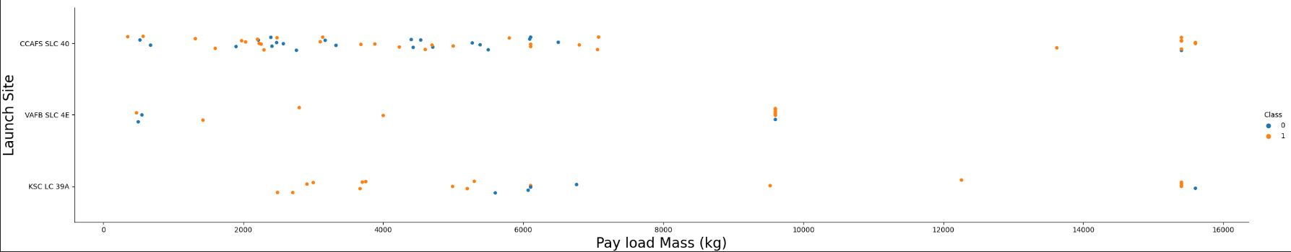
LAUNCH SITE vs. PAYLOAD MASS
In this plot the y axis is the launch site and the x axis is the payload mass. The dots represents if it was a successful launch.

Slide 19
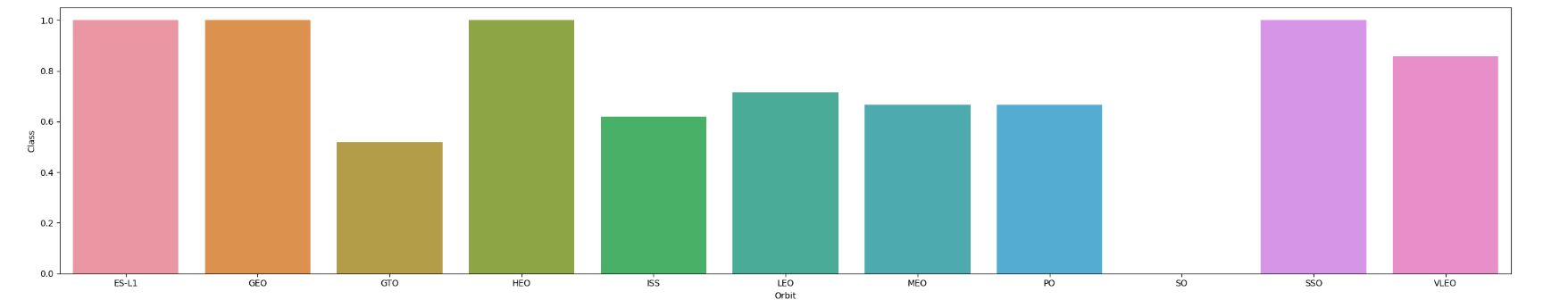
Success Rate vs. Orbit Type
The x axis is the launch site and the y axis is the success rate.

Slide 20
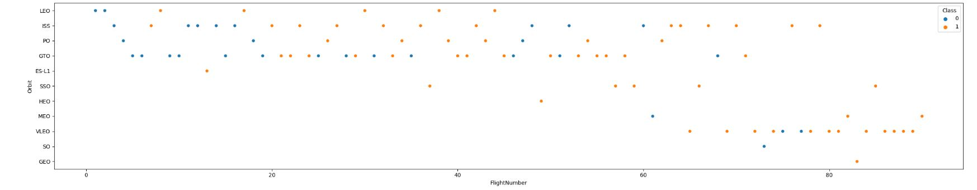
Orbit Type vs. flight number
The x axis is the flight number and the y axis is the orbit type. The coulure of the dots represents if it was a success.

Slide 21
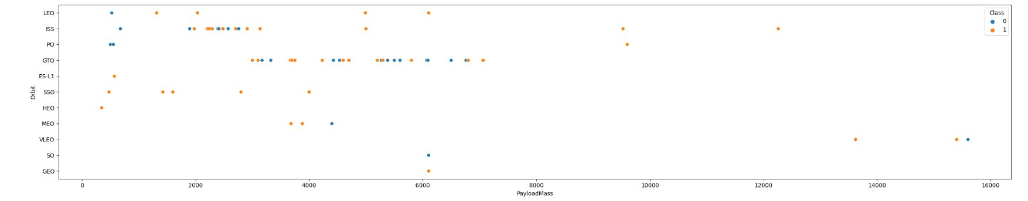
ORBIT TYPE VS. PAYLOAD MASS
The x axis is the payload mass and the y axis is the orbit type. The coulure of the dots represents if it was a success.

Slide 22
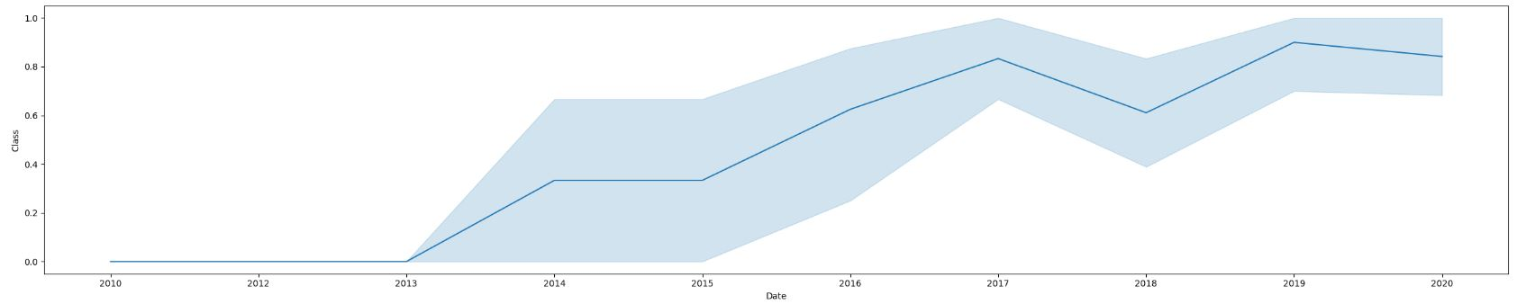
Launch Success Yearly Trend
The x axis is the date and the y axis is the success rate.

Slide 23
EDA - WITH SQL

Slide 24
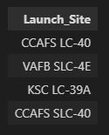
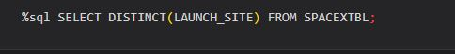
All Launch Site Names
Display the names of the unique launch sites in the space mission
DISTINCT returns all unique values in the LAUNCH_SITE column from SPACEXTBL table.

Slide 25
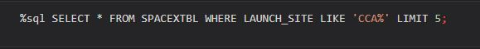
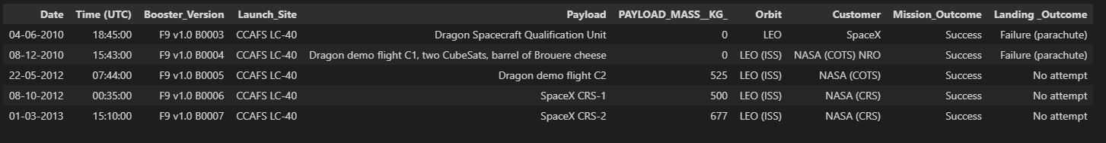
Launch Site Names Begin with 'CCA'
Display 5 records where launch sites begin with the string 'CCA'
LIMIT 5 gives only 5 rows, and LIKE ‘CCA%’ is used to only give string values beginning with ‘CCA’.

Slide 26
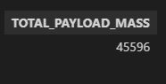
Total Payload Mass
Display the total payload mass carried by boosters launched by NASA (CRS)
SUM is used to summarize the numeric values of the LAUNCH column, and the WHERE filters the results to only boosters from NASA (CRS).

Slide 27
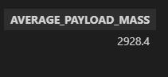
Average Payload Mass by F9 v1.1
Display average payload mass carried by booster version F9 v1.1
AVG gives the average of the PAYLOAD_MASS__KG_ column, WHERE only selects results of the F9 v1.1 booster version.

Slide 28

FIRST SUCCESSFUL GROUND LANDING DATE
List the date when the first succesful landing outcome in ground pad was acheived.
MIN gives the earliest date from the DATE column and the WHERE filters the results to only the successful ground pad landings.

Slide 29
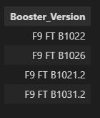
Successful Drone Ship Landing with Payload between 4000 and 6000
List the names of the boosters which have success in drone ship and have payload mass greater than 4000 but less than 6000
WHERE filters the to the data we want the AND is used so multiple restrictions can be used and BETWEEN narrows the search between 4000 < x < 6000.

Slide 30
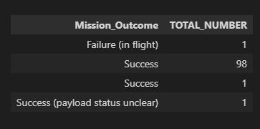
Total Number of Successful and Failure Mission Outcomes
List the total number of successful and failure mission outcomes
COUNT is used to summarize the total number of each mission outcomes, GROUPBY groups the results by type of mission outcome.

Slide 31
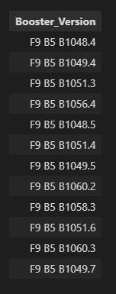
Boosters Carried Maximum Payload
List the names of the booster_versions which have carried the maximum payload mass. Use a subquery
SELECT statement in brackets is a subquery that finds the maximum payload, it is then used in the WHERE condition. DISTINCT then gives only distinct booster versions.

Slide 32
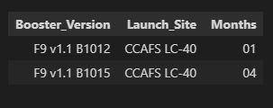
2015 Launch Records
List the records which will display the month names, failure landing_outcomes in drone ship ,booster versions, launch_site for the months in year 2015.
WHERE is used to filter the results for only failed landing outcomes, AND only for the year of 2015.

Slide 33
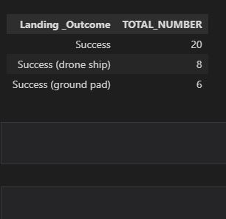
Rank Landing Outcomes Between 2010-06-04 and 2017-03-20
Rank the count of successful landing_outcomes between the date 04-06-2010 and 20-03-2017 in descending order.
BETWEEN filters so only between the dates are selected which is used with LIKE so only successful landings are chosen. GROUP BY is used to group the findings and ORDER BY orders them DESC is then used to specify the descending order.

Slide 34
LAUNCH SITES PROXIMITY ANALYSIS – FOLIUM INTERACTIVE MAP

Slide 35




ALL LAUNCH SITES ON A MAP
The SpaceX launch sites are all on coasts of USA(Florida and California).

Slide 36






SUCCESS/FAILED LAUNCHES FOR EACH SITE
For each site the launches was grouped into clusters, were successful launches was markt with green icons and red icons if it failed
VAFB SLC-4E
KSC LC-39A
CCAFS SLC-40 and CCAFS LC-40
$$=$$

Slide 37
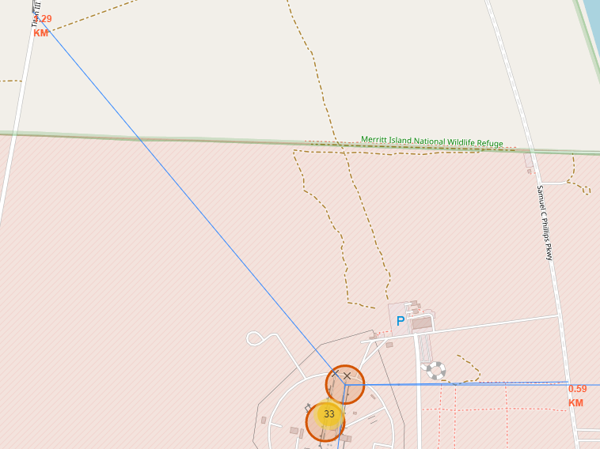
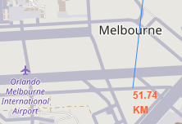
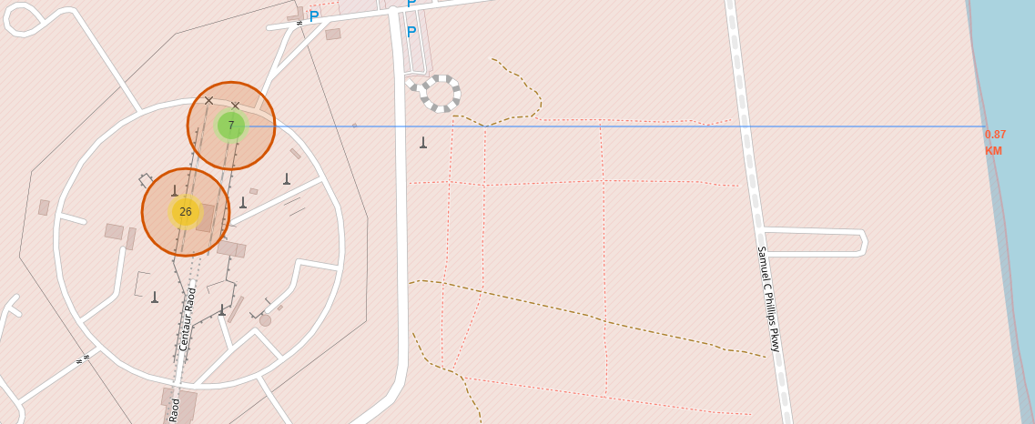
PROXIMITY OF LAUNCH SITES TO OTHER POINTS OF INTEREST
If we take the launch site CCAFS SLC-40 for example we can see the following when it comes to distance to points of interest.
The launch site is less then 1km away from the coastline and highway, the closets railway is only 1.29km away.
The launch site is also kept a distance from city's, the nearest city is 52km away.

Slide 38
interactive dashboard - Plotly Dash

Slide 39

launch success count for all sites
The Launch site with the most successful launches was KSC LC-39A and the one with the least was CCAFS SLC-40

Slide 40


Pie chart for the launch site with highest launch success ratio
KSC LC-39A was the launch site with the highest success rate.
Note: $class\left\{\begin{aligned}0, Failure \\ 1, Success\end{aligned}\right.$

Slide 41
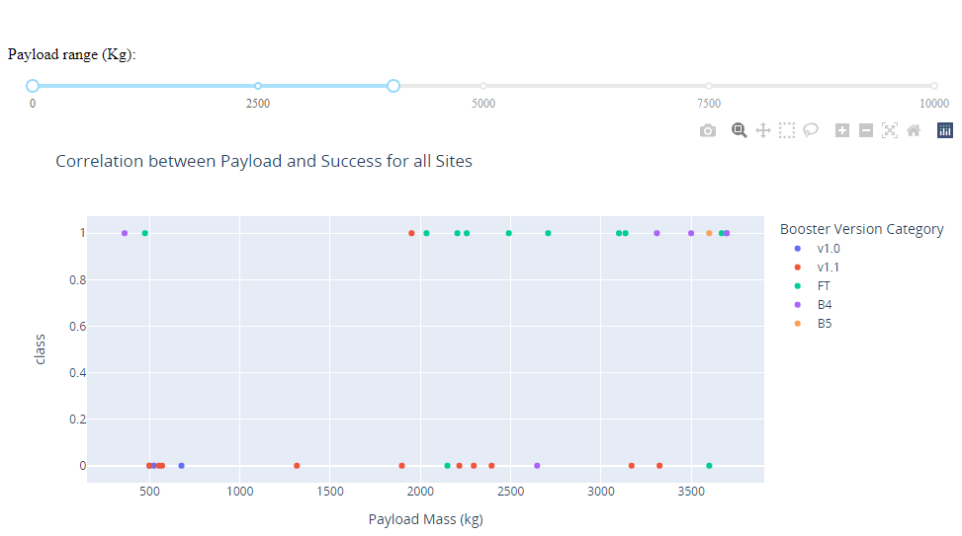

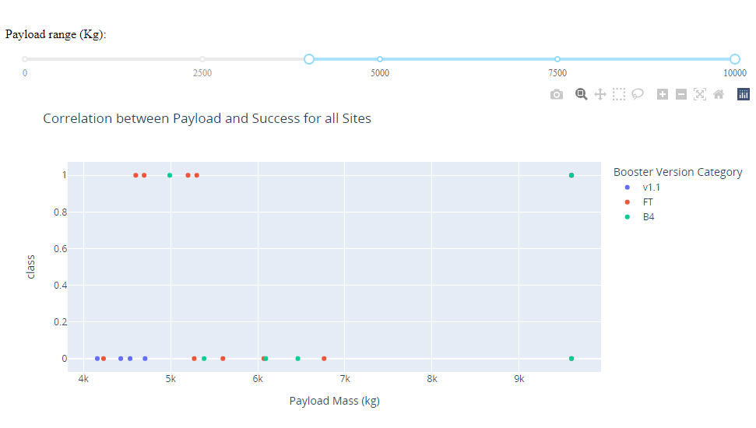

Launch Outcome VS. Payload scatter plot for all sites
1
The plot bellow display all the launches but the plot 1 and 2 are narrowed down to low payloads(0-4000kg) and high payloads(4000-10 000 kg) from these plot we can see that the launches with low payload have more successful launches.
Note: c$lass\left\{\begin{aligned}0, Failure \\ 1, Success\end{aligned}\right.$
2
1
Low payloads
2
High payloads

Slide 42
PREDICTIVE ANALYSIS - CLASSIFICATION

Slide 43
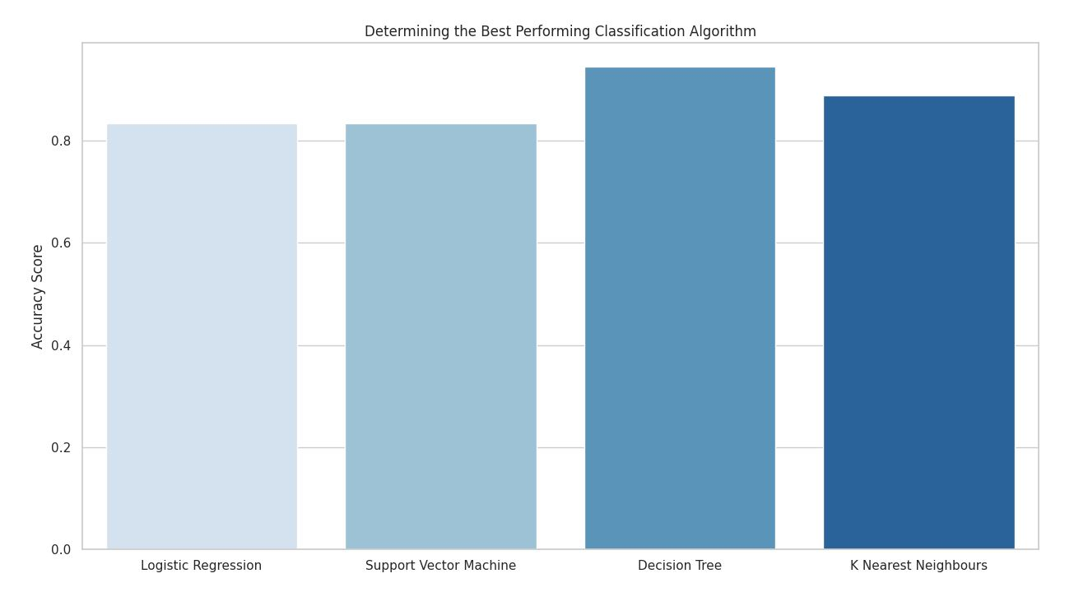
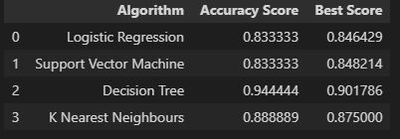
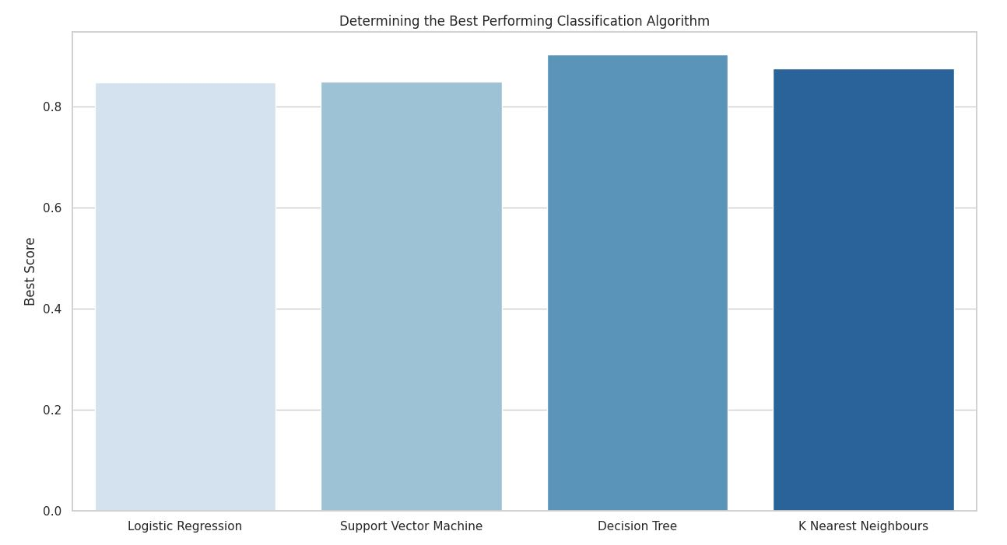
CLASSIFICATION ACCURACY
We can see from the data and the bar charts that the Decision Tree model hade the best results.

Slide 44
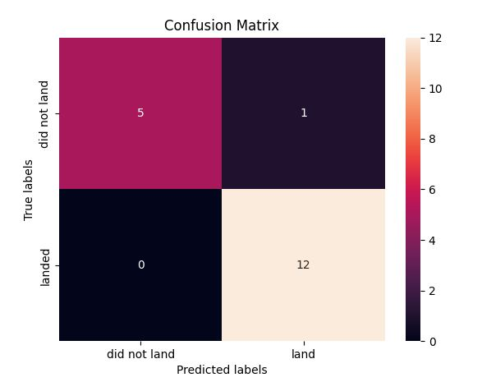
Confusion Matrix
This is the confusion matrix for the Decision Tree model. In it we can see that it predicted a total of 17 landing outcomes correctly were 12 landed successfully and 5 did not land successfully. There was only one prediction that was wrong and it was a false posetiv.

Slide 45
CONCLUSIONS

Slide 46
CONCLUSIONS
As they have launched more flights over the years we can see that there success rate has gone up meaning they are getting more consistent results.
We can see that some orbit type have better success rate than others.
Launches with low payload(under 4000kg) had better success rate then the heavy launches.
The Decision Tree model was the best performing classification model and hade an accuracy of 94.44%.

Slide 47
APPENDIX
All code can be found in my github

